Slide 1


Go-Session-3
---------------------
Concurrency
By Shadab Akhtar

Slide 2
--------------------------------------------------------------------------------------------------
Module Introduction
--------------------------------------------------------------------------------------------------
In this module, we will cover
Use of Concurrency in Go Programming
Concurrent execution of tasks
Execution of multiple tasks simultaneously.
Concurrency using Goroutines

Slide 3
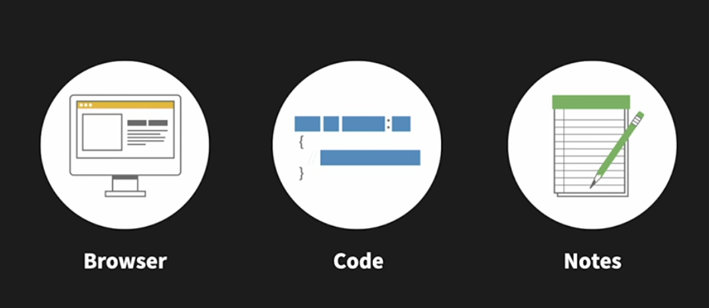
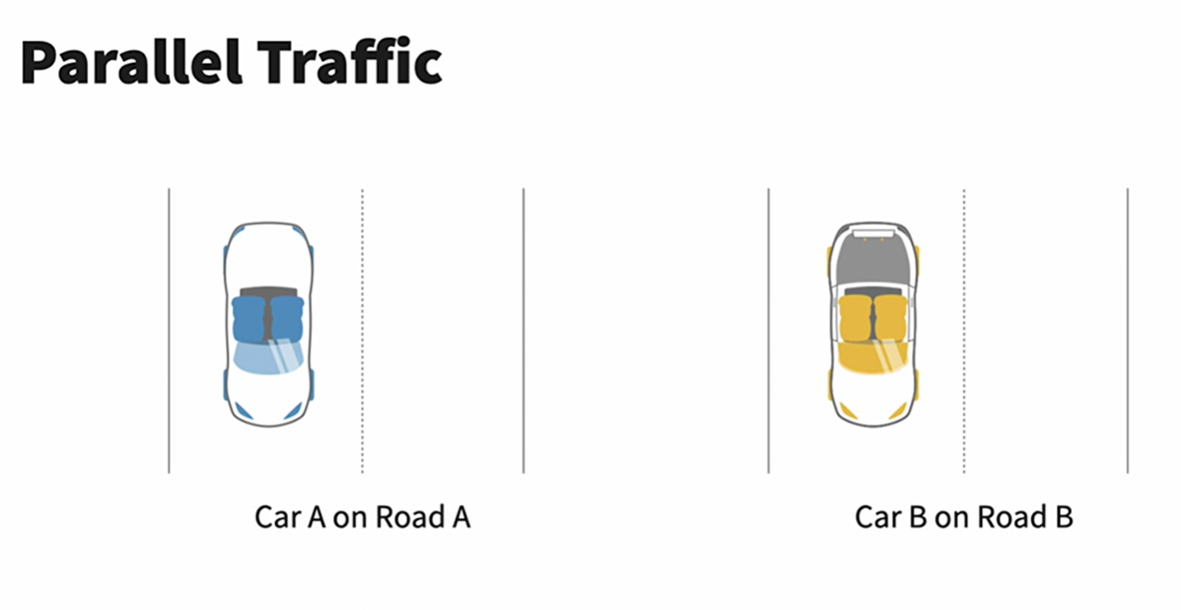
------------------------------------------------------------------------------------------------
Use of Concurrency in Go Programming
------------------------------------------------------------------------------------------------
Concurrency is a fundamental feature of the Go programming language, and it is designed to help developers write efficient and scalable programs.

Slide 4
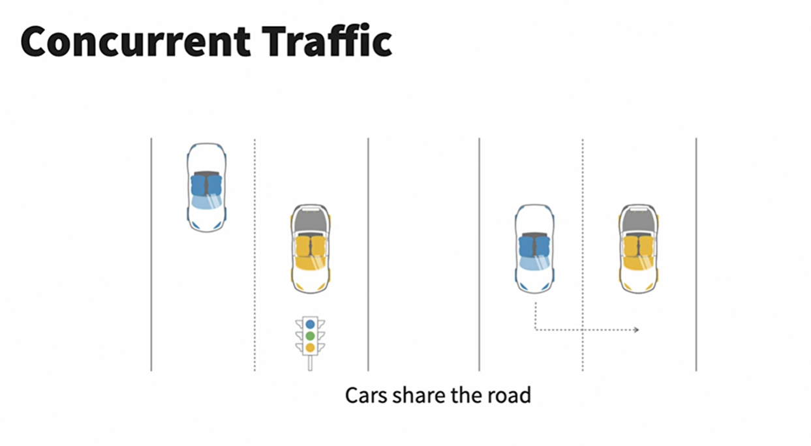

Slide 5
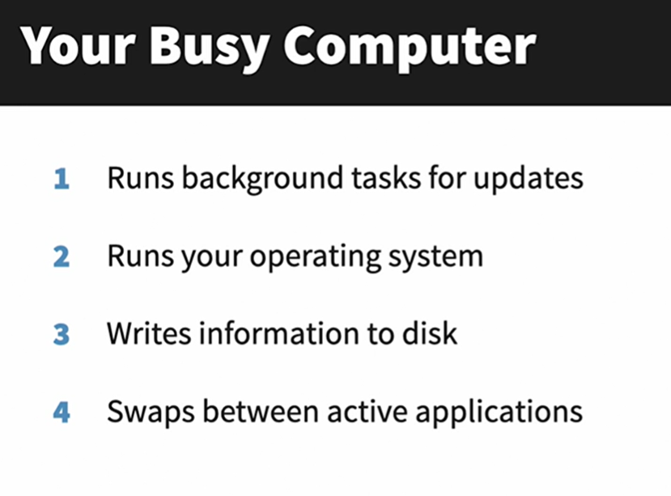

Slide 6
Here are some common use cases and benefits of using concurrency in Go:
Parallelism: Go allows you to execute multiple tasks simultaneously, which can lead to significant performance improvements on multi-core processors. You can use Goroutines to parallelize tasks, such as data processing, to take full advantage of available CPU cores.
Responsive User Interfaces: In graphical user interface (GUI) applications and web servers, concurrency ensures that the user interface remains responsive even when performing time-consuming tasks in the background. For instance, you can use Goroutines to handle user requests concurrently in a web server without blocking other requests.
I/O Operations: Many programs spend a significant amount of time waiting for I/O operations to complete, such as reading from files or making network requests. Concurrency allows you to overlap these operations, making the most of your CPU's idle time while waiting for I/O.
Resource Utilization: Concurrency can help you make better use of system resources. For example, you can use Goroutines to manage a pool of worker threads for tasks like image processing, database connections, or handling client connections in a network server.
Asynchronous Programming: Go makes it easy to work with asynchronous tasks by using Goroutines and channels. This is useful for scenarios like handling multiple network requests concurrently and processing the results as they become available.

Slide 7
Parallel Algorithms: Go's concurrency primitives enable the development of parallel algorithms, which can speed up computations in fields like scientific computing, machine learning, and data analysis.
Task Pipelining: You can build complex data processing pipelines by chaining Goroutines together. Each Goroutine can perform a specific task, and data flows from one stage to another efficiently. This is often used in data processing and transformation workflows.
Fault Tolerance: Concurrency can improve the fault tolerance of your applications. For instance, you can use Goroutines to create redundant service instances, ensuring that a failure in one Goroutine doesn't bring down the entire application.
Load Balancing: In server applications, Goroutines can be used to manage load balancing across multiple server instances, distributing incoming requests evenly to ensure optimal resource utilization.
Real-Time Systems: Concurrency is valuable in real-time systems, such as robotics and sensor data processing, where tasks need to be executed in parallel with strict timing requirements.
In Go, Goroutines and channels are the primary building blocks for implementing concurrency. Goroutines are lightweight, and Go's runtime system efficiently manages them, making it easy to create and coordinate many concurrent tasks. Channels provide a safe and efficient way for Goroutines to communicate and synchronize their work.
While concurrency can lead to improved performance and responsiveness, it also introduces challenges related to synchronization and data sharing. Go provides mechanisms like channels, mutexes, and atomic operations to address these challenges and ensure safe concurrent programming.

Slide 8


Slide 9
--------------------------------------------------------------------------------------------------
Module Summary
--------------------------------------------------------------------------------------------------
In this module, we have covered
-------------------------------
Use of Concurrency in Programming
Concurrent execution of tasks
Execution of multiple tasks simultaneously.
Concurrency using Goroutines

Slide 10


